Slide 1



GET
FUTURE
READY
Our Strategy 2031

Slide 2
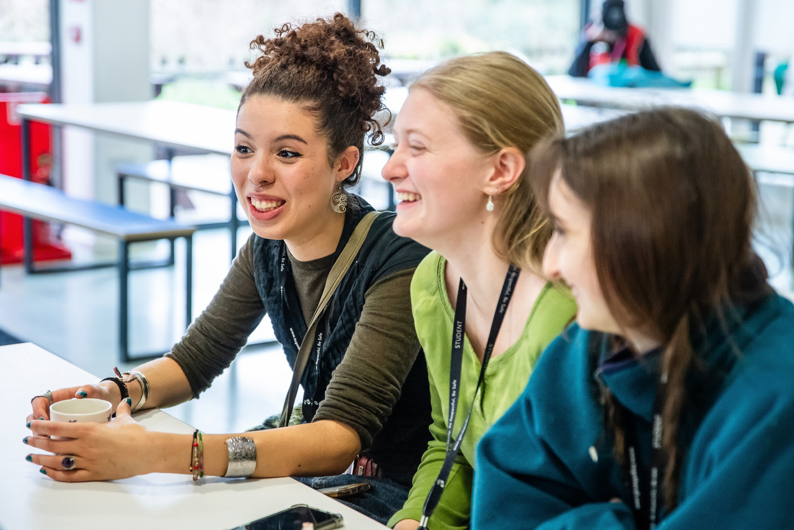
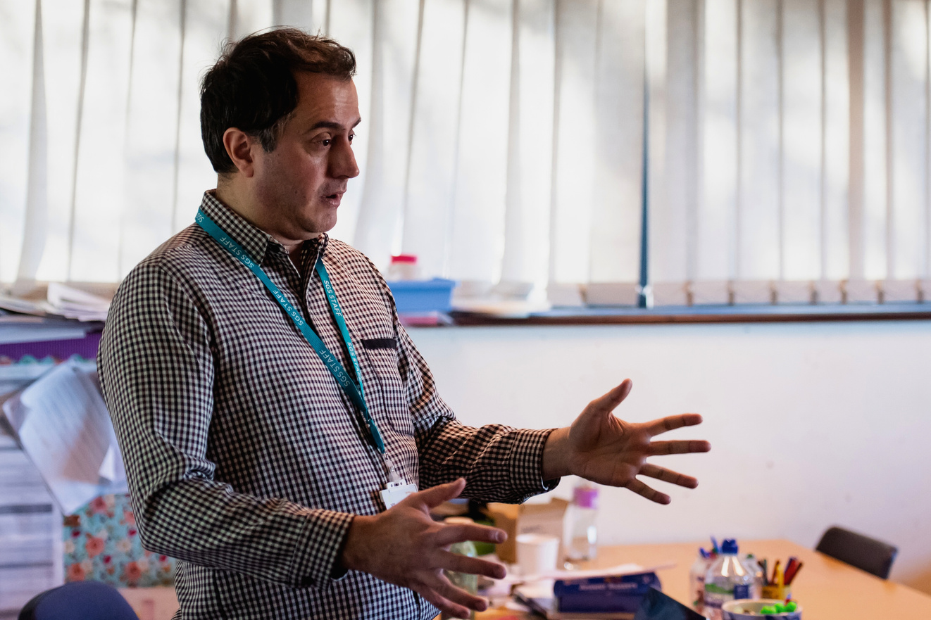


We Are About...​
COMMUNITY
We open doors for every individual within our communities to access top class education, training and facilities, enabling social cohesion and economic prosperity across our region. ​

Slide 3

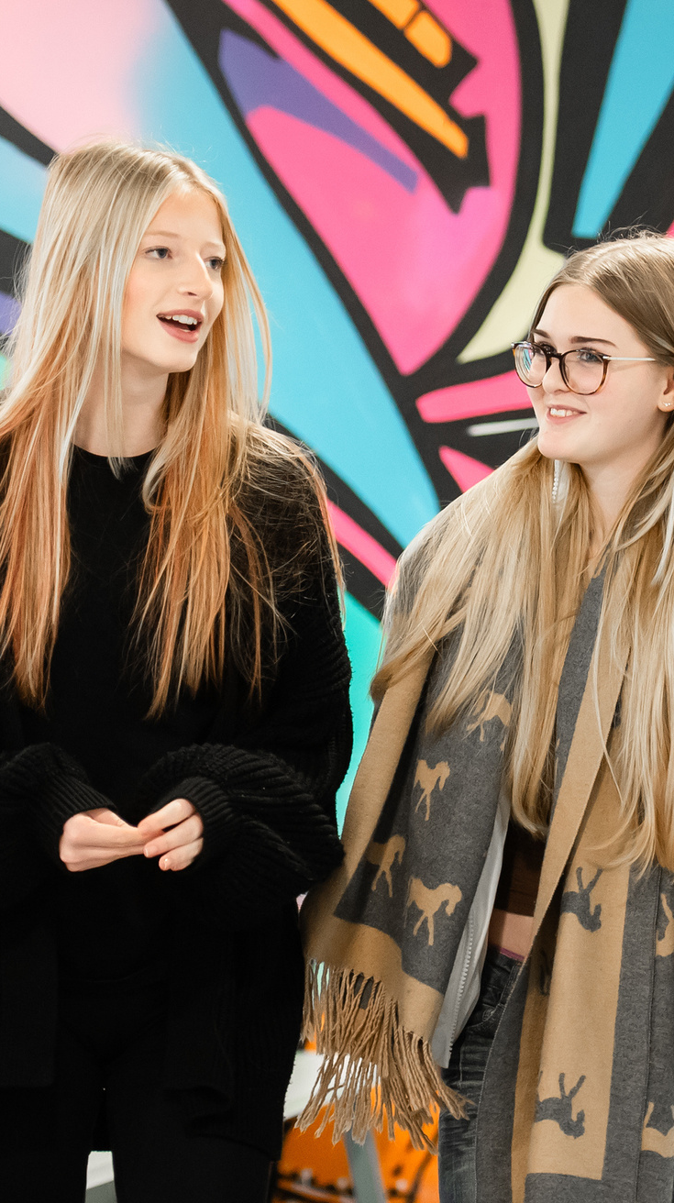




How will we measure our success?
Enrolments - the number of students that enrol at SGS, demonstrating our reputation for quality learning in the communities we serve
Regional economic growth - the economic prosperity of the regions we serve, showing how we contribute to overall growth within our communities
NEET numbers - the number of young people not in employment, education or training, showing how we are contributing to the social and economic health of our communities

Slide 4
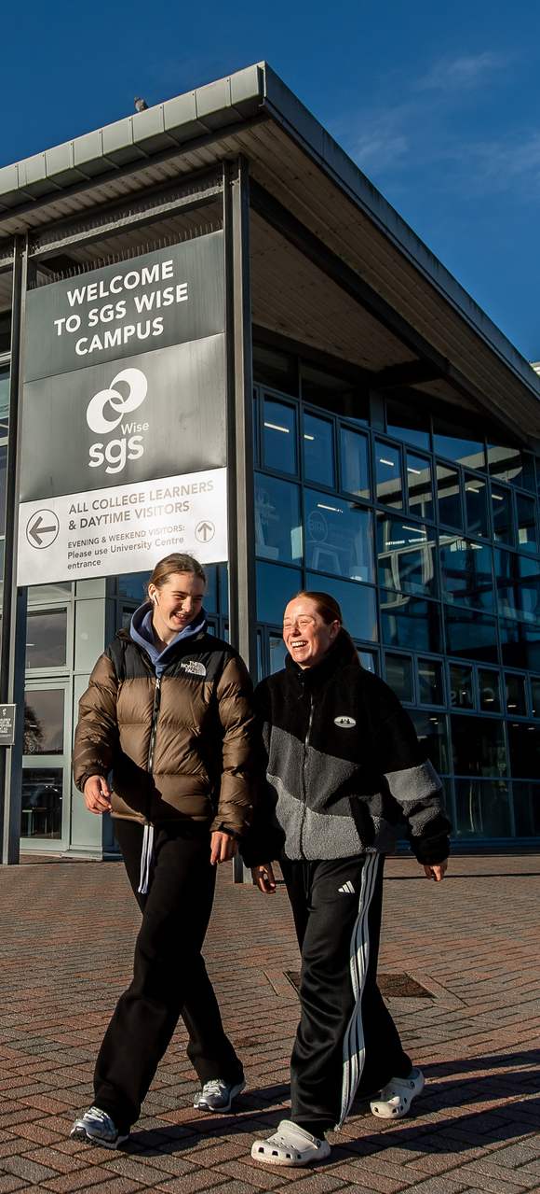



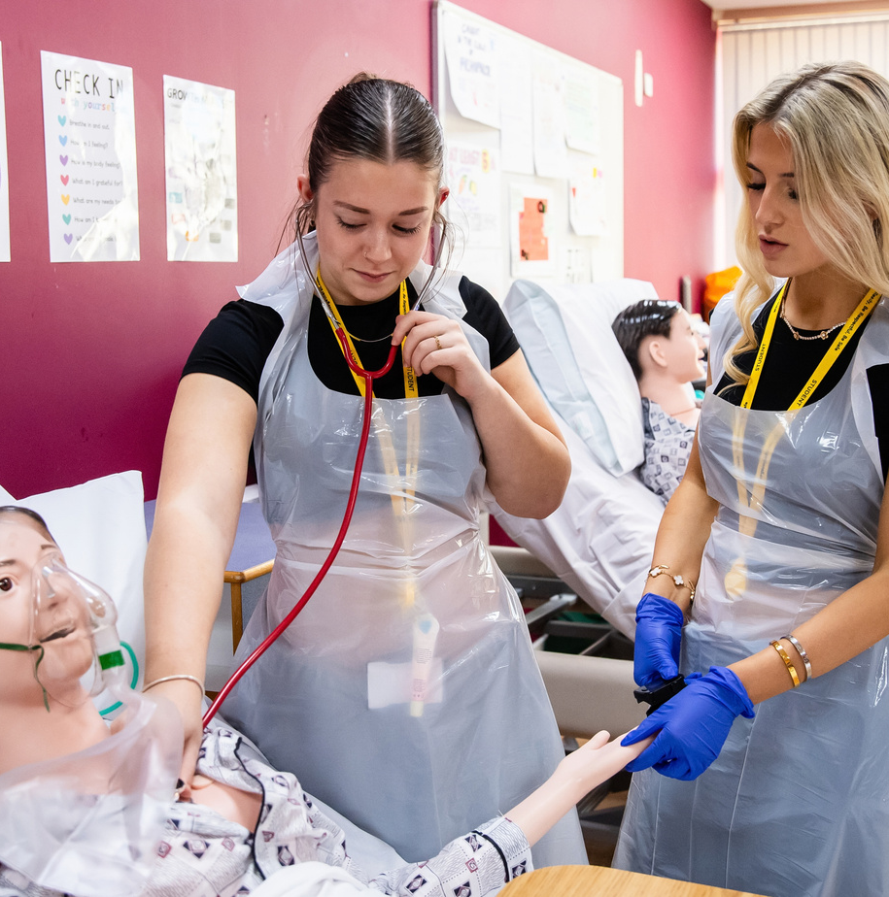
What will we do to deliver this outcome?
High quality learning opportunities for local communities
Break down barriers to learning and employment
Turn our campuses into vibrant community hubs
Forge powerful employer partnerships
Make the education system more cohesive and
student-centred

Slide 5
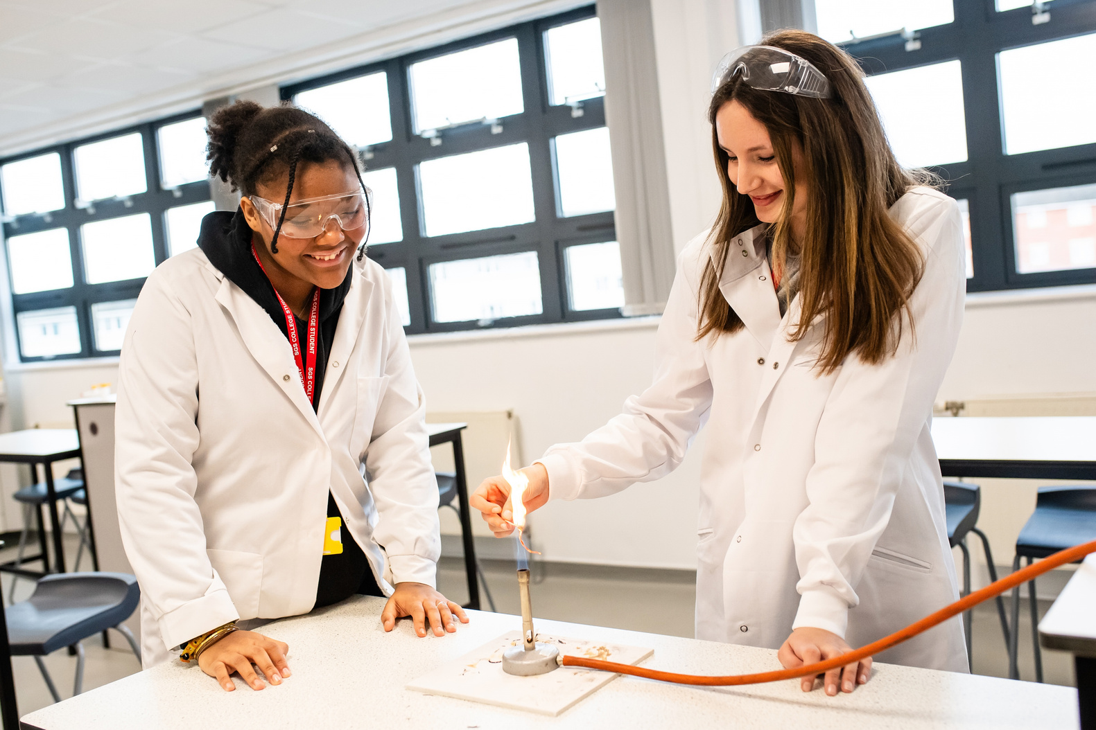
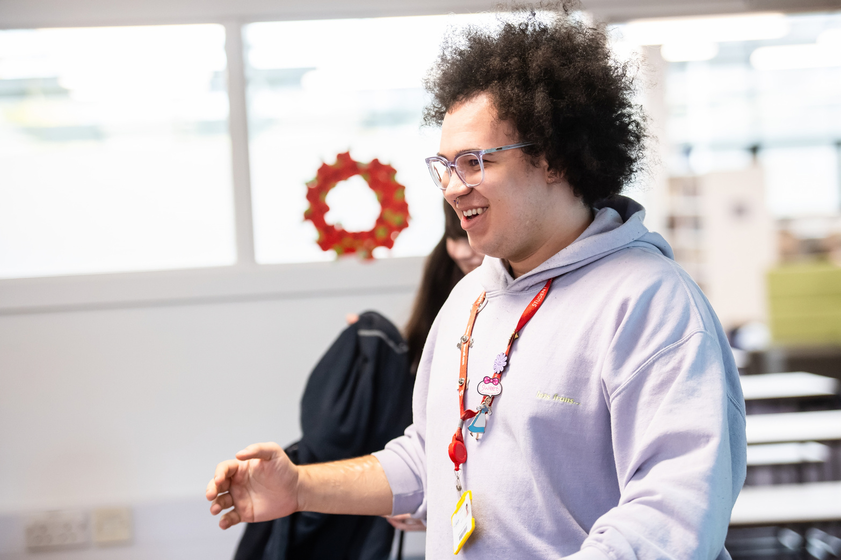
We Are About...​
ACHIEVEMENT​
We inspire everyone to achieve their qualifications and surpass their own expectations to give every student the best possible springboard for their future careers. ​

Slide 6
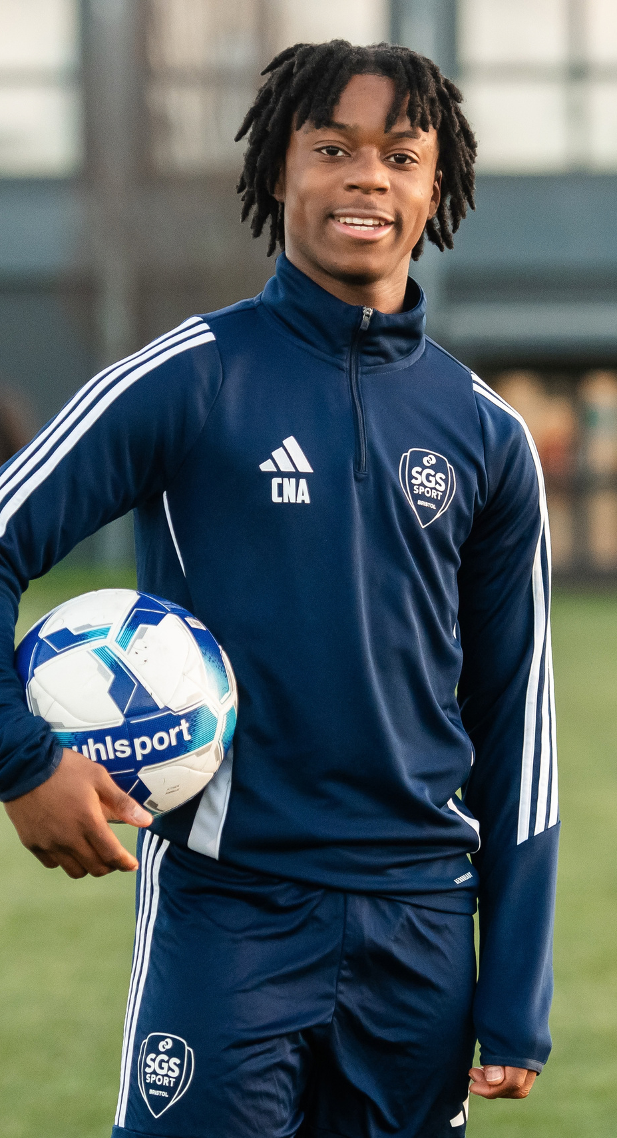



How will we measure our success?
Our Qualification Achievement Rates – as measured by the Department for Education
High grades - demonstrating our focus on stretching students and ensuring high levels of achievement
Progress rates - measuring individual student progression to demonstrate the value added from our teaching and learning

Slide 7
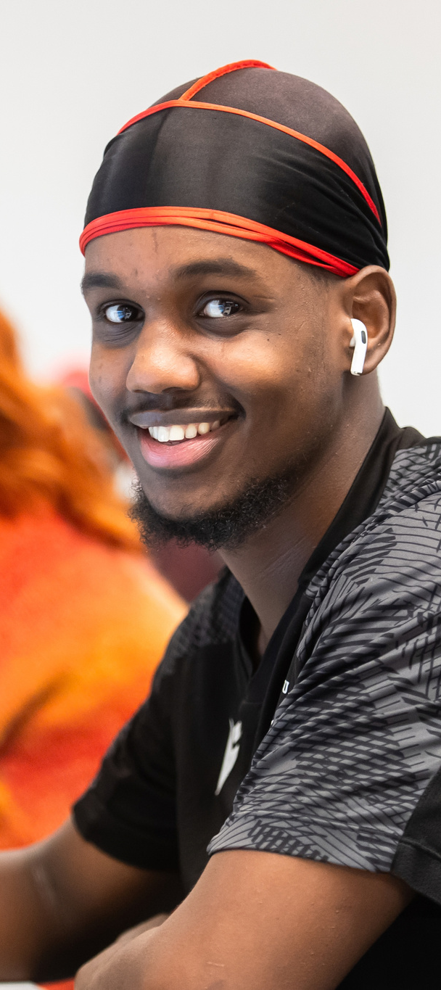
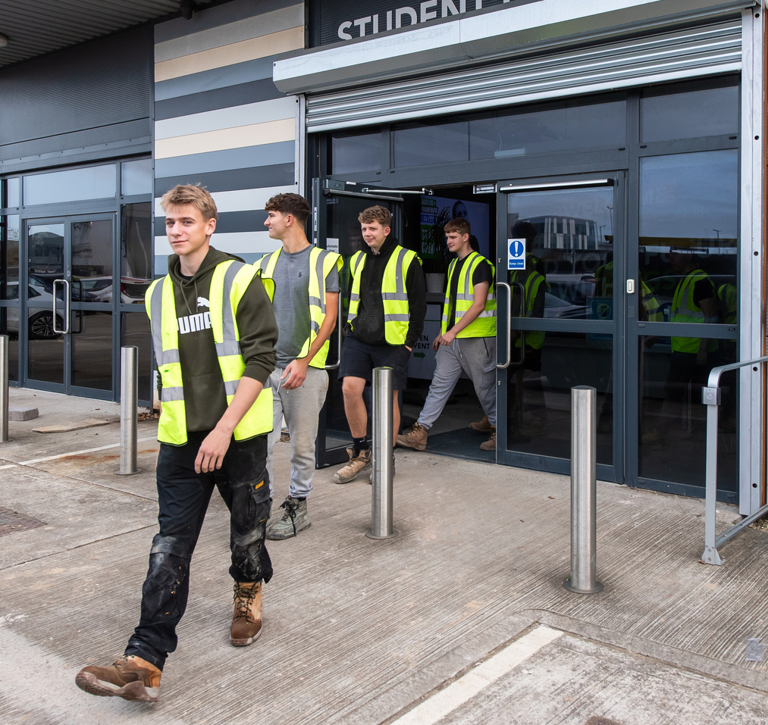
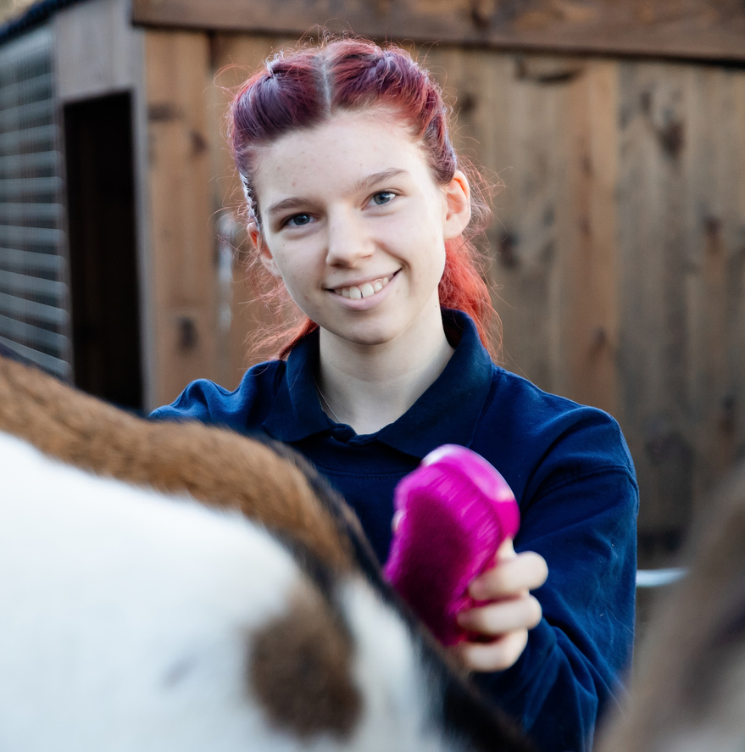
What will we do to deliver this outcome?
Exceptional teaching and learning
Create the conditions for consistent learning
Ensure every student is progressing throughout the year
Strong pastoral care and student support
A commitment to effective parental and carer engagement for 14-18 year olds

Slide 8
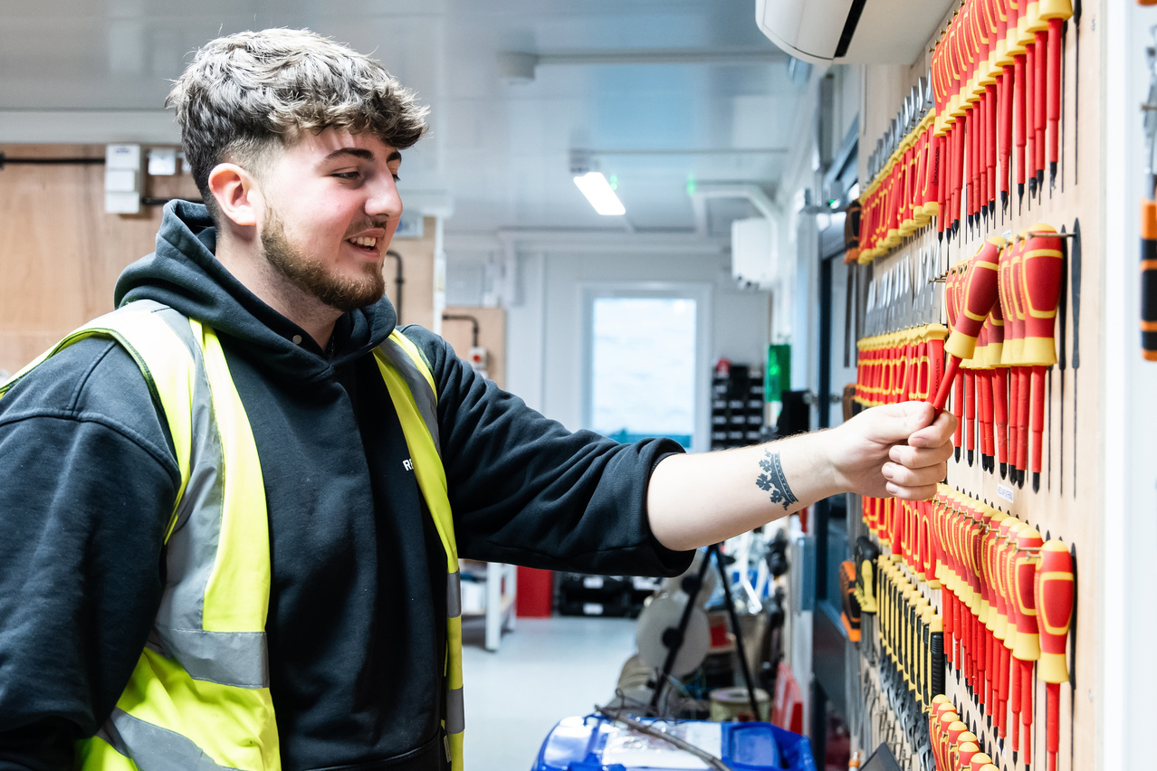
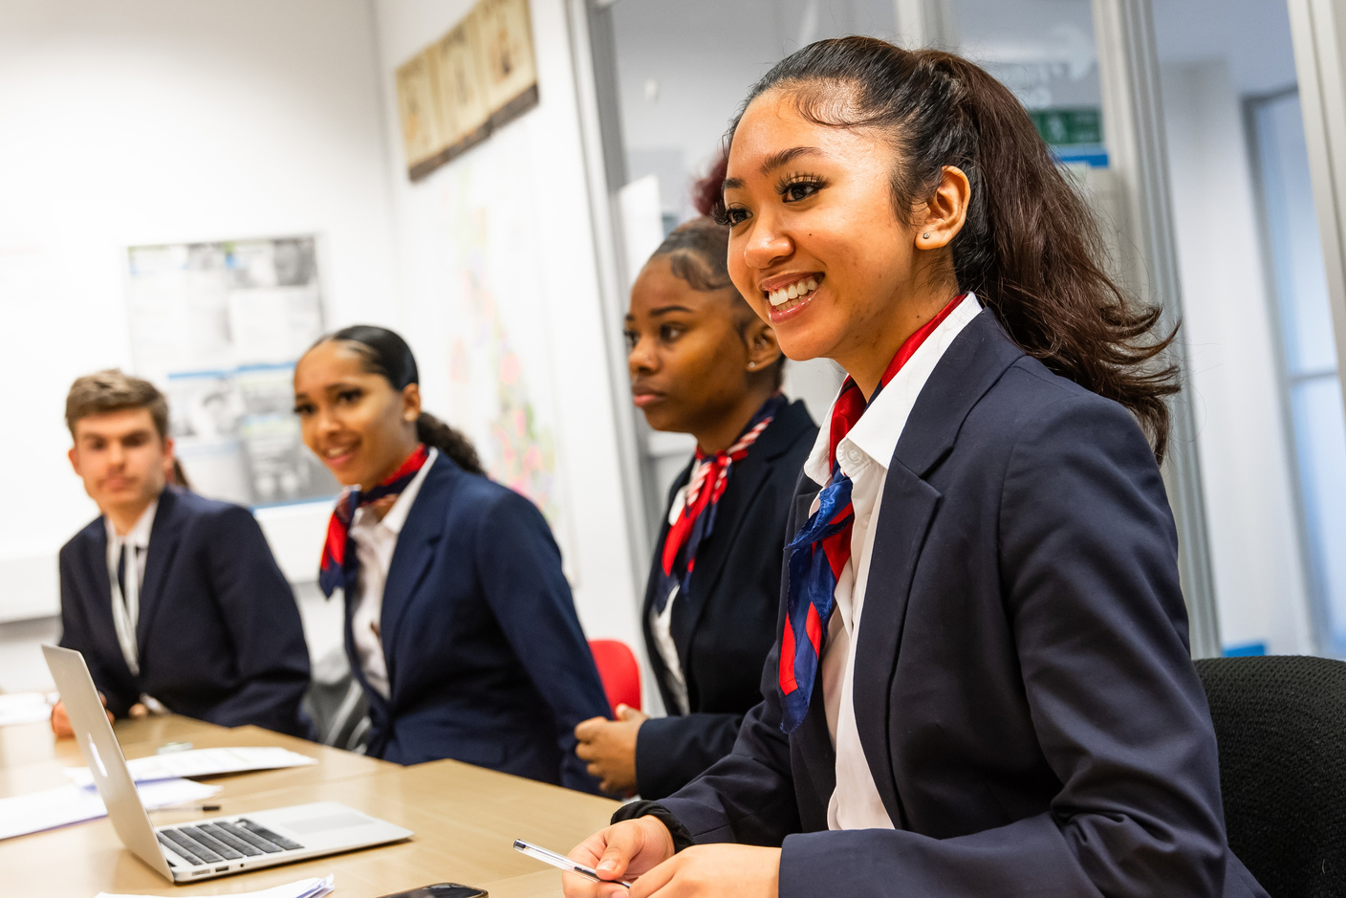
We Are About...​
READINESS​​
We are the springboard to the world of work, further study and life and we prepare our students by giving them the confidence, skills and resilience to thrive in their next stage and beyond. ​

Slide 9
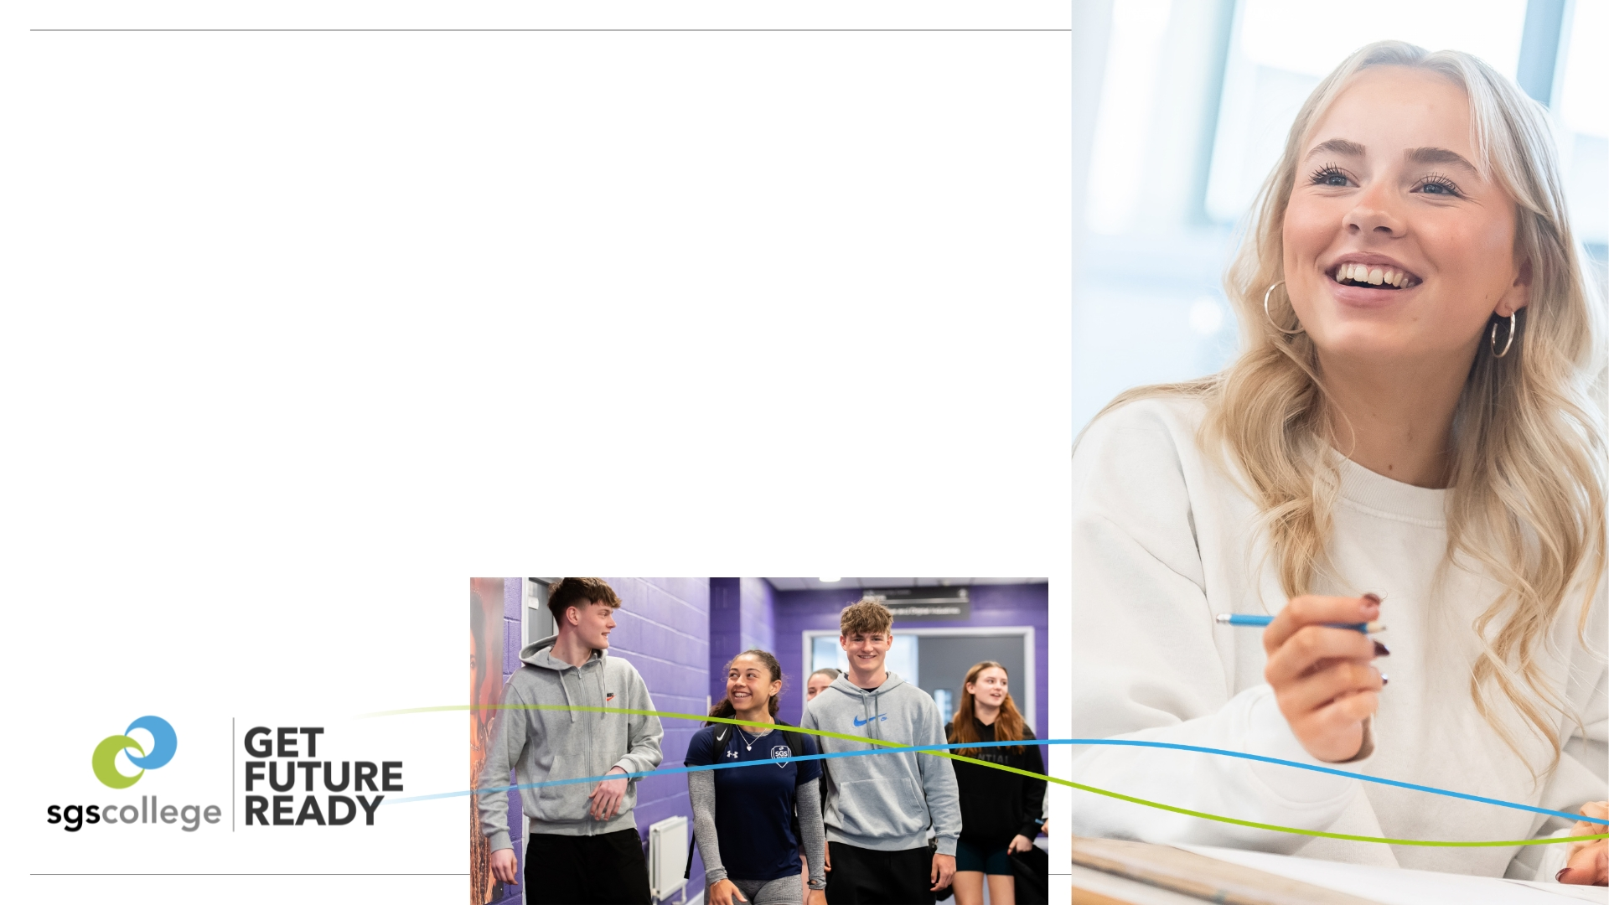



How will we measure our success?
Progression rates - progression into further learning to support clear pathways for students
Employment rates - how many of our students
are moving into employment
Employer feedback - survey data from employers of SGS, students and alumni, measured annually

Slide 10

What will we do to deliver this outcome?
Deliver transformative curriculum that anticipates the needs of tomorrow’s society
Expand our pathways for additional, specialist and high needs education
Further enhance our reputation as a leading sports college
Deliver employability and digital skills accreditation for all students
Build stronger relationships with schools to support enhanced readiness for students arriving at SGS
Learning that goes beyond the classroom

Slide 11
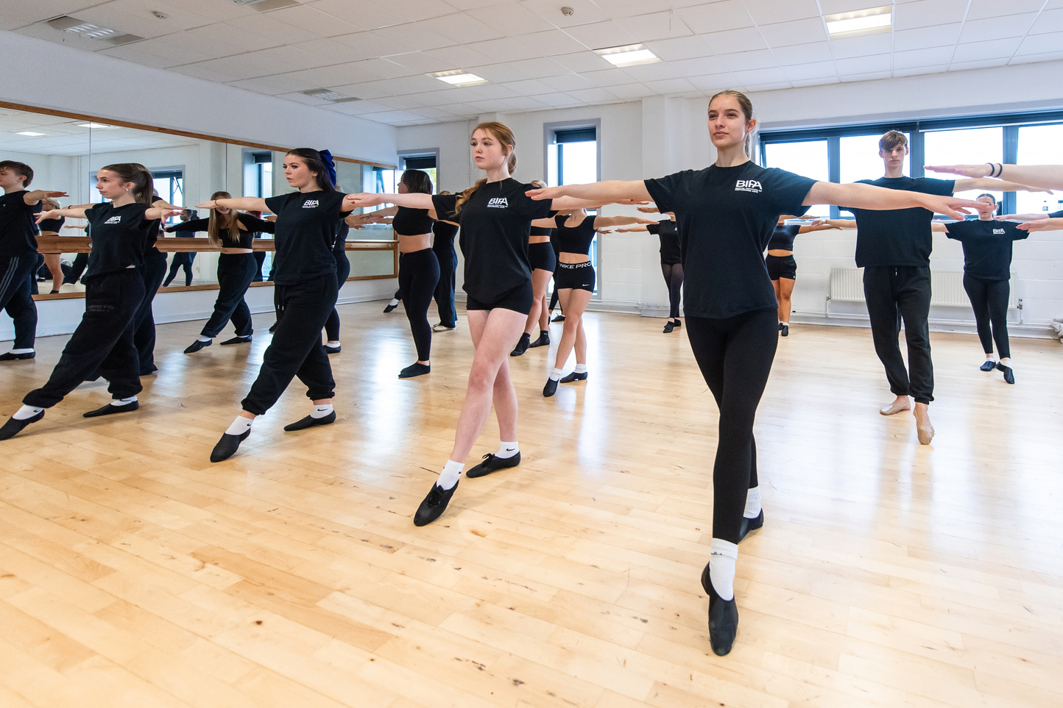
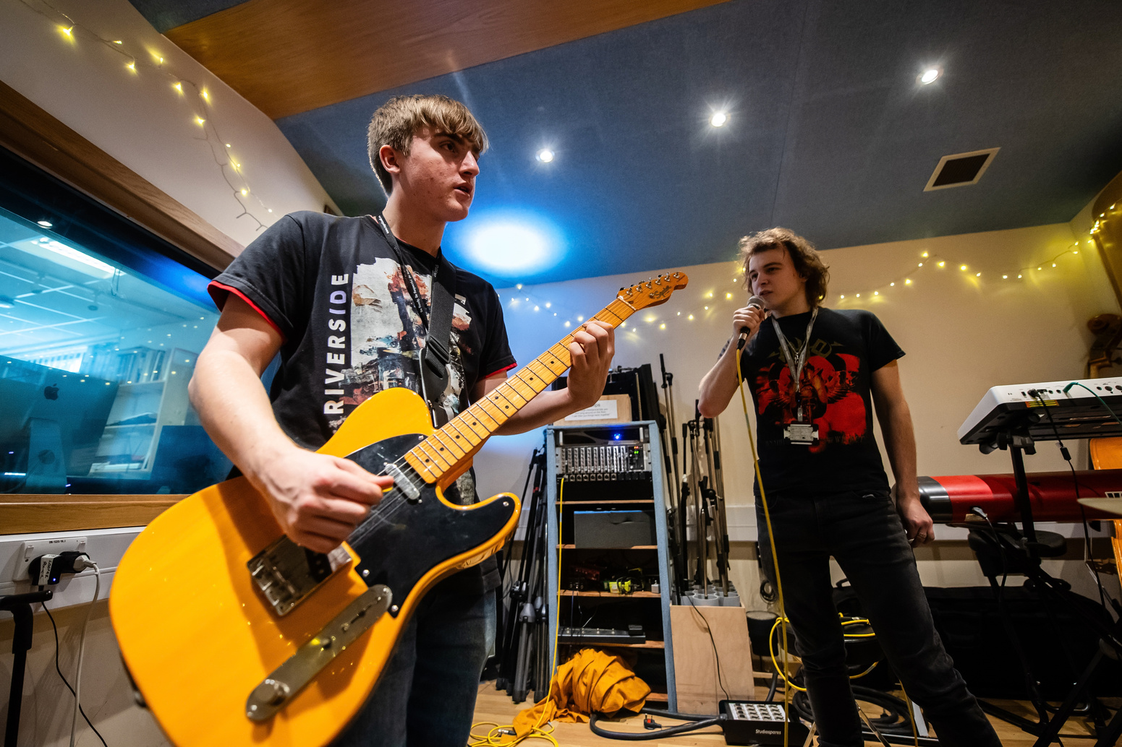
We Are About...​
ENJOYMENT​
We provide brilliant experiences every day by creating an inspiring, inclusive and supportive environment where students thrive, our people feel valued and stakeholders engage in genuine partnership.

Slide 12




How will we measure our success?
High attendance - demonstrating the desire of our students to come to college
High retention - students enjoying the experience of being at SGS and wanting to continue their learning here
Positive feedback - from our students and our people in regular surveys and forums

Slide 13

What will we do to deliver this outcome?
Make enjoyment a core part of SGS culture by embedding it in everything we do
Teaching that creates a love of learning
Give our students and people a clearer role in determining the direction of the College
Enhance the availability of college facilities for extra-curricular activities

Slide 14


